Slide 1
Subject: DATA MINING
Lecturer: Dr.PHAUK Sokkhey and CHAN Sophal
Class: M1 Computer Science
Presenter: HUON Sophy

Slide 2
ETL Datawherehous
Using Pentaho

Slide 3
Content
Introduction (ETL Process)
Pentaho Data Integration(PDI)
Installation
Advantages and Disadvantages
Demo

Slide 4
I. Introduction
Pentaho is business intelligence (BI) software that provides data integration, OLAP(Data Discovery and Analysis) services, reporting, information dashboards, data mining and extract, transform, and load (ETL) capabilities (Wikipedia).
ETL (extract, transform, load) process is the most popular method of collecting data from multiple sources and loading it into a centralized data warehouse. ETL is an essential component of data warehousing and analytics.

Slide 5
I. Introduction (Cont.)
Features of Pentaho
ETL capabilities for business intelligence needs
Report Designer
Product Expertise
Offers Side-by-side subreports
Professional Support
Query and Reporting
Offers Enhanced Functionality
Full runtime metadata support from data sources

Slide 6
II. Pentaho Data Integration(PDI)
Kettle (ETL tool) has been recently acquired by the Pentaho group and renamed to Pentaho Data Integration. It is a leading open-source ETL application on the market.
Kettle is a set of tools and applications which allows data manipulations across multiple sources.

Slide 7
II. Pentaho Data Integration(PDI) (Cont.)
The main components of Pentaho Data Integration are:
Spoon is a graphical interface used to create transformations and jobs.
Pan is an application dedicated to run data transformations designed in Spoon.
Kitchen is a batch-style command line tool used to run jobs
Carte is a web server that can be used to run jobs on remote servers.

Slide 8
II. Pentaho Data Integration(PDI) (Cont.)
The data sources and supported databases in Kettle ETL are:
- Any database using ODBC on Windows - Oracle - MySQL - AS/400 - MS Access - MS SQL Server - IBM DB2 - PostgreSQL - Intersystems Caché | - Informix - Sybase - dBase - Firebird SQL - MaxDB (SAP DB) - Hypersonic - CA Ingress - SAP R/3 System (using the ProSAPCONN plugin)

Slide 9
III. Installation
The basic requirements for installation
Pentaho Data Integration Community Edition
JRE 1.8 and jdk1.8.0_77 or above (Java Runtime Environment)
Windows 7 or above (PDI can be installed in Linux or Max OS)

Slide 10
III. Installation (Cont.)
To install the Community Edition:
Go to the Pentaho download page on SourceForge: http://sourceforge.net/projects/pentaho/files/Data%20Integration/.
Extract the contents of the compressed file to <PDI_Location> on your local machine.
Verify that the data-integration folder is present in <PDI_Location>.

Slide 11
III. Installation (Cont.)
To install a free trial of the Enterprise Edition:
Go to the Big Data Integration and Analytics page on the Hitachi Vantara website.
Click START YOUR 30-DAY TRIAL.
Extract the contents of the compressed file to <PDI_Location> on your local machine.
Start the installer and follow the installation instructions.
Verify that the data-integration folder is present in <PDI_Location>.

Slide 12
IV. Advantages
Pentaho BI is a very intuitive tool. With some basic concepts, you can work with it.
Simple and easy to use Business Intelligence tool
Offers a wide range of BI capabilities which includes reporting, dashboard, interactive analysis, data integration, data mining, etc.
Comes with a user-friendly interface and provides various tools to Retrieve data from multiple data sources
Offers a single package to work on Data

Slide 13
IV. Advantages (Cont.)
Has a community edition with a lot of contributors along with Enterprise edition.
The capability of running on the Hadoop cluster
JavaScript code written in the step components can be reused in other components.

Slide 14
IV. Disadvantages
The design of the interface can be weak, and there is no unified interface for all components.
Much slower tool evolution compared to other BI tools.
Pentaho Business analytics offers a limited number of components.
Poor community support. So, if you don’t get a working component, you need to wait till the next version is released.

Slide 15
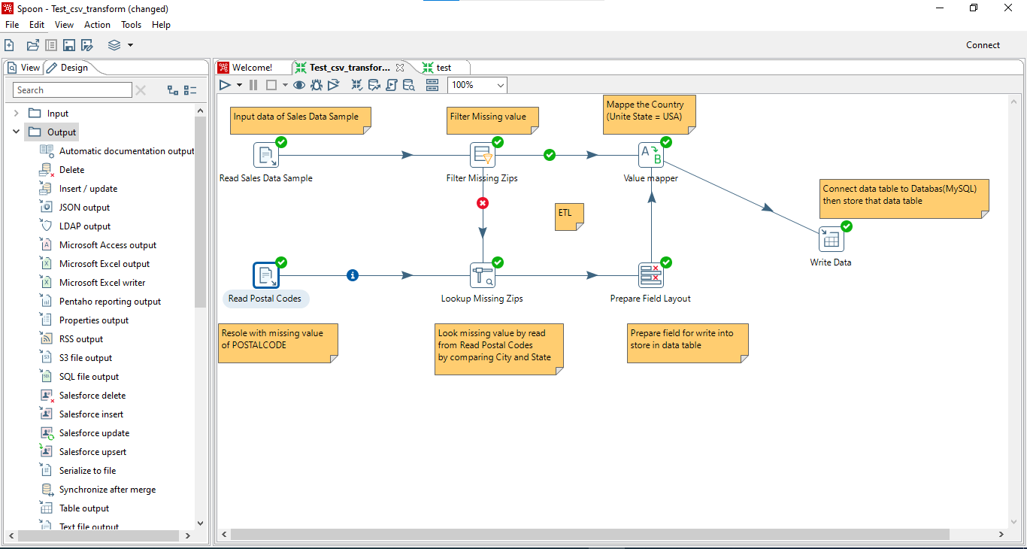
V. Demo

Slide 16
Thank you

